Slide 1

Sparse PCA through Low-rank Approximations
ICML 2013
Atlanta
Dimitris Papailiopoulos
UT Austin
Based on Joint work with:
Alex Dimakis (UT Austin)
Stavros Korokythakis
(stochastic technologies)
Notes:
-Hi, I will present a new sparse PCA algorithm that uses low-rank approximations of the data-set and comes with provable approximation guarantees.
-This is joint work with my advisor Alex Dimakis from UT Austin and Stavros Korokythakis.

Slide 2
Overview: PCA and Sparse PCA
Principal Component Analysis (PCA): classic algorithm for dimensionality reduction, clustering, etc.
Sparse PCA is a useful variant because of interpretability
(text analysis, gene expression data analysis, portfolio optimization, etc.)
… but is NP-hard
We present:
- A new sparse PCA algorithm suitable for large-scale data sets
- Provable approximation guarantees
- Experiments on large-scale Twitter data (millions of Tweets)
Notes:
- So, as we all know PCA is one of the most used tools for dimensionality reduction, clustering and other applications.
Sparse PCA is a useful variant of PCA that has found many applications.
The major benefit of sparse PCA is interpretability. A few features per component explain topics or gene contributions to a disease better than thousands of features.
However, due to its combinatorial constraints sparse PCA is an NP-hard problem
Here I will present a new algorithm for sparse PCA that is suitable for large-scale data sets
And comes with provable approximation guarantees
I will finally present you with some of our experiments on a large-scale Twitter data set that comprises of millions of tweets.

Slide 3
Sparse PCA explained on Tweet Analysis
Notes:
I will explain the sparse PCA problem in the context of Twitter analysis.
But, the same discussion can be carried for any other of its applications.

Slide 4
Modeling a Tweet
We represent each tweet as a long (100K), sparse vector (~5 nonzeros)
with 1s in word indices
word 1
word 2
word 100K
I
really
love
Lady
Gaga
Notes:
- Let us assume that our data set is a large collection of tweets.
Each tweet is a small collection of words, maybe 5 or 10.
We can use a vector representation for each tweet.
Each vector will be very long, each position will corresponds to a word. And we put a 1 if a word appears in the corresponding tweet, or 0 if it doesn’t.
Here for example “I” could be second word, “really” could be word 1thousand and so on.

Slide 5
Data Sample Matrix
We collect all tweet vectors in a sample matrix of size
tweets
words
show
flood
flood
flood
Underlying theme:
politics
personal
personal
personal
Notes:
- So we collect all these tweets as columns in a big sample matrix S.
Here we have m tweets and n is the number of words.
Each column here is a tweet, so this is a tweet this is another tweet and so on.
Whenever there is a 1 it means that it appears in such a tweet.
As you might assume there are underlying themes in these tweets, like politics, or maybe something big happens like a flood or a quake.
And you would like to analyze this collection of data to be able to identify such trends and events.

Slide 6
Vanilla PCA finds an “EigenTweet”
Q: How to identify a potentially major topic/trend?
A: Find a vector that closely matches most tweets
i.e, a vector that maximizes the sum of projections (the match) with each tweet
Notes:
So how do can we identify major topics or trends?
One way to do it algebraically, is to generate a collection of vectors (tweets) that closely match most tweets in our data set.
So we could find vectors that maximize the sum of projections, which is our match function.
This problem, can be stated as finding vectors that maximize the explained variance of the data matrix S, or the sample covariance matrix A
Here A is equal to SS’.
If we pose no combinatorial constraints on the solution vectors, this optimization problem is solved by vanilla PCA.
The answer to this optimization is the top singular vector of the data matrix S, which we can compute in polynomial time

Slide 7
The problem with PCA
Top Eigenvector will be super dense!
We want sparse
Sparse = Interpretable
Strong
Communities
Japan
Morning
Deals
Engage
Uprising
Protest
Elections
teachers
Summer
support
Schools
.
.
.
Crisis
Earthquake
IMF
banks
0.1
0.02
.
.
.
0.001
Dense =
A tweet with thousands of words
(makes no sense)
Strong
Earthquake
Japan
Morning
0.75
0.49
0.23
0.31
Notes:
A major issue with vanilla PCA is that the output principal components will be super dense.
Now in this application, a super dense vector is equivalent to a tweet with thousands of words.
So super dense is not interpretable, because all possible topics and collections of words mix up with each other.
What we would ideally like to have is principal components that are very sparse, maybe 5-10 words.
This is why sparsity implies interpretability in this applications, and this is why sparse PCA will be useful.

Slide 8
Sparse PCA
Algorithms:
Kaiser 1958, Jolliffe 1995, Jolliffe et al. 2003, Zhou et al. 2006, Moghaddam et al. 2006, Sriperumbudur et al. 2007, Shen and Huang 2008, d'Aspermont et al. 2007, d'Aspermont et al. 2008, Yuan and Zhang 2011, Ma 2011, Zhang et al. 2012 Asteris Papailiopoulos Karystinos 2011
Few model based approximation/statistical guarantees:
[Amini & Wainwright 2008, Yuan & Zhang 2011, Ma 2011, d’Aspermont et al. 2012]
Sparse PCA is NP-Hard
[Natarajan et al.] [Moghaddam et. Al]
Notes:
So we can add the sparsity constraint to our original PCA optimization.
Here we want to maximize the quadratic form x’Ax subject to the extra constraint that the vector x has only k nonzero entries.
This sparsity constraint is exactly what makes the problem hard to solve.
Many algorithms have been proposed for this problem, with some of them coming with model specific statistical approximation guarantees.

Slide 9
Our Contributions
Notes:
And this brings us to our contributions.

Slide 10
Our Result
We present a combinatorial algorithm for sparse PCA.
Obtain general provable approximation guarantees.
Theorem:
For any desired accuracy parameter the Spannogram algorithm runs in time and constructs a - sparse vector
such that:
where
Notes:
We present a new combinatorial algorithm for sparse PCA that comes with provable approximation guarantees.
Our main theorem is the following:
For any desired accuracy parameter d, our Spannogram algorithms runs in time n^d and computes a k-sparse vector x_d
This vector has metric, that is a 1-epsilon_d factor away from the optimal explained variance
We bound this epsilon_d error in the folloiwng:
Epsilon_d is less than two quantities, which depending on the structure of our data either of them can be tighter.
The first bound is the ration of the number of words to sparsity times the spectral ratio between the first and the d+1 eigenvalue of the matrix A
Here n is the number of words, k is the sparsity, lambda_1 the largest and lambda_d+1 the d+1 largest eigenvalues of A.
The second bound is the ratio of the d+1 eigenvalue of A to the largest diagonal element of A, lambda_1^1.
In the context of twitter analysis this diagonal entry corresponds to the maximum number of occurrences of a word

Slide 11
Corollaries
Theorem:
For any desired accuracy parameter the Spannogram algorithm runs in time and construct a - sparse vector such that:
where
Cor1: If there is any decay in the eigenvalues, i.e.,
then there exists a contant s.t. for all linear size supports
we obtain a constant factor approximation to sparse PCA
Cor2: If there is a power law decay in the eigenvalues:
Then, for any ε>0, we can approximate Sparse PCA within a factor of ε in time polynomial in n, k (but not in 1/ε) (PTAS guarantee)
Notes:
- Using our approximation bound we can two corollaries about generic spectrum profiles of data.
The first corollary says that if there is any decay in the eigenvalues of A, that is if the lambda_1 is larger than lambda_d+1, then there…
Then our second corollary say that under a popular spectrum profile, that is the power law eigenvalue decay, we can obtain a polynomial time approximation for any desired accuracy parameter

Slide 12
Word Elimination
The complexity is , but is still very high!
Bad news: Cannot really run on big data sets like that.
Good news: We introduce a provably safe word elimination
Elimination results (#words left) from Twitter data set when d=2, k=10
Spannogram needs months on Core2duo 2.53Ghz 4GB RAM
n | 1,000 | 10,000 | 100,000
ñ (elim) | 20 | 30 | 35
Spannogram took seconds
Notes:
Now as you might be already thinking, the complexity although polynomial in n, has a very high exponent even if d = 2 or 3.
This means that we cannot really run our algorithms in data sets that have more than a thousand words.
Our solution to this problem is to introduce a new provably safe feature elimination procedure that is very successful in real data sets.
For example, in our twitter data set, when we set d=2 and k = 10, our elimination can bring the words from a hundred thousand down to 35.
If we compare running times, our algorithm requires more than a couple fo month for n = 100K.
It only needs a few seconds if we use the elimination.

Slide 13
The Algorithm
Notes:
So here is the algorithm

Slide 14
Our sparse PCA algorithm:
SVD
Word Elimination
Approximation Guarantees
Constant rank solver
[Asteris, Papailiopoulos, Karystinos]
Check sets on A
Keep the best one
Notes:
Our input is A, the sample covariance matrix.
We first compute a rank-d approximation of A
Then we apply our word elimination routine which outputs a much shorter version of A_d, call it A_hat
A_hat is fed to a constant rank sparse PCA solver, that Asteris, myself, and Prof. Karystinos have developed.
This solver produces a number of candidate k-sparse supports.
We test these polynomially many supports on our original matrix A and keep the one with the best metric.
Our approximation guarantees are proven for this box.

Slide 15
How it works
- If we knew the support of the sparse PC, it’s easy.
(Zero out all but a k x k submatrix of A, ﬁnd largest eigenvector of that).
- We can naively solve sparse PCA by testing all supports.
- But…
Rank-1 case:
Q: Find the k-sparse vector that maximizes the inner product with a given vector
A: Sort the absolute entries of , keep the k largest. (aka PC thresholding)
Key lemma [Asteris, Papailiopoulos, Karystinos]:
“If the matrix is rank d, only supports must be tested.”
For the rank-1 case there is only one support that we need to check:
The k-largest elements of the first eigenvector
Notes:
Let’s first see how the constant rank solver works. This is important to understand how the elimination woks
If we knew the support of the optimal sparse PC, the problem is easy.
We just need to zero out all entries of A, but the ones indexed by that set. Then we need to compute the largest eigenvector of that zero-ed out matrix
So we can naively solve sparse PCA by checking all n choose k supports, which can be exponentially many.
Now in our work with Asteris and Karystinos we prove that if the matrix is rank-d only n^d supports must be tested.
Let us visit the rank-1 case.
Here we approximation A, with A1, the rank-1 approx. of A that equals v1v1’, its first eigenvector product
For the rank-1 case the things are simple.
The initial maximization boils down to a maximization over sparse vectors of an inner product.
So here is a simpler question, equivalent to the problem.
How do I maximize the inner product of a vector v_1 with a k-sparse variable vector x.
I simply need to keep the k largest entries of v_1 and put all of the power there.

Slide 16
Rank-2 Approximation
Now we have
Claim:
There is a special vector in the span of and such that:
Proof:
is generated from a 2 dimensional subspace
Q: How many top-k supports can there be in a 2-dimensional subspace?
The problem for rank -2 reduces to a combinatorial question:
Q: How many candidate supports are in a 2-dimensional subspace
Cauchy-Schwarz

Slide 17
A 2-dimensional problem
Q: number of different top-k supports in ?
A: At least 2: top k support of and top k of
Total number =
To prove this we will use a spherical vector [APK11,KL10]
And we will visit all possible vectors

Slide 18
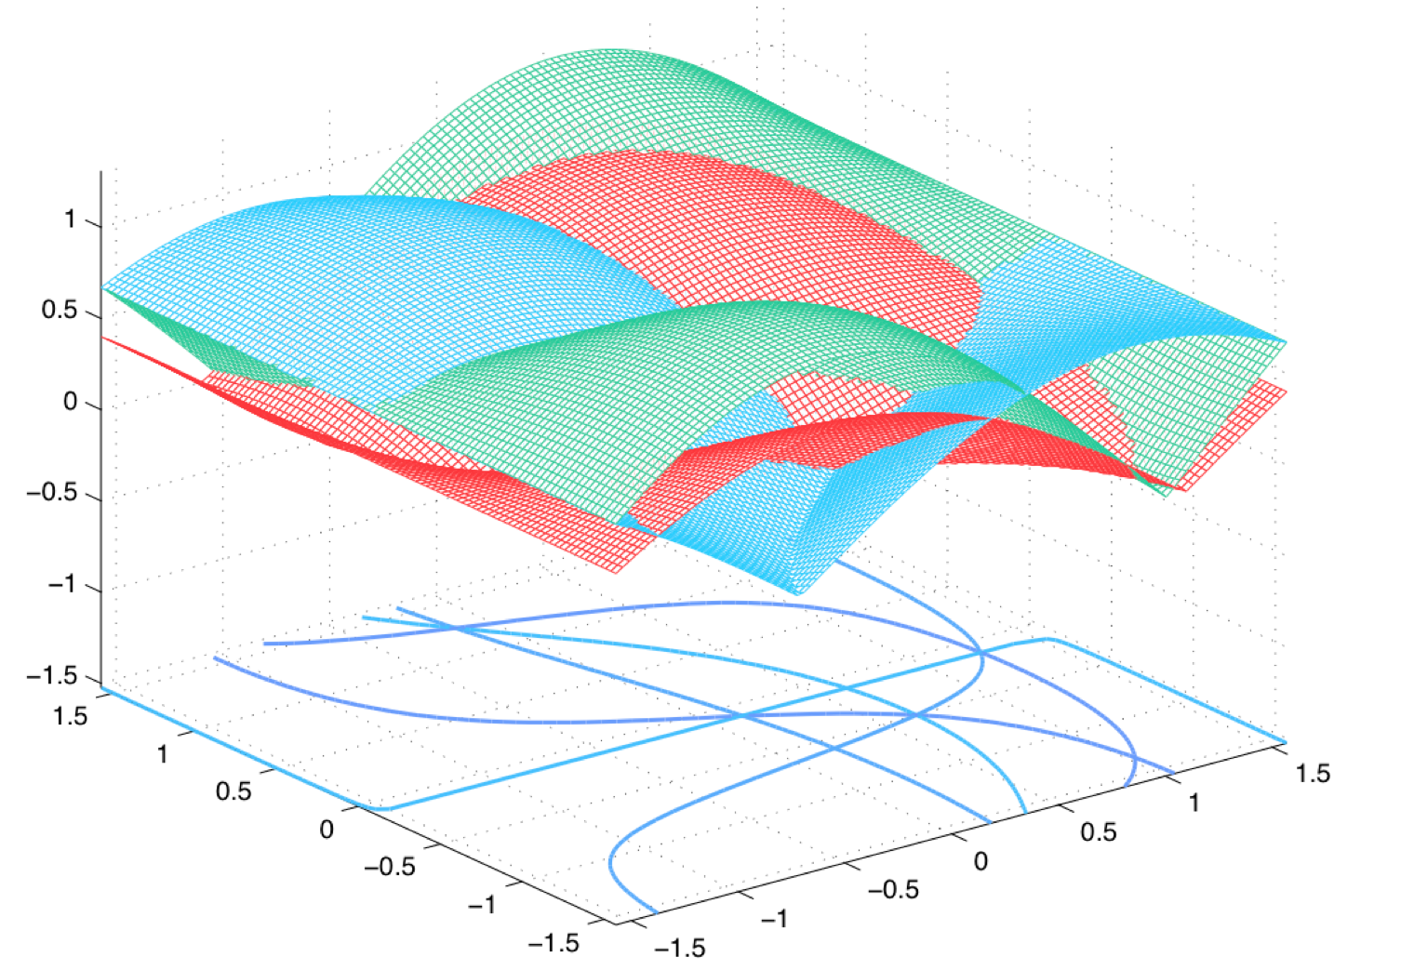
The Spannogram
Let’s see how all vectors in the 2-dim. span look like:
Each element is a curve
Lets count top-k sets.
Key lemma [Asteris, Papailiopoulos, Karystinos]:
“If the matrix is rank d, only supports must be tested.”
curves
every pair of curves intersects in exactly 2 points.
Local top-3 support
{2,5,1}
Local top-3
support
{2,5,4}
Total number of intersection points (total k-supports)

Slide 19
Our algorithm:
SVD
Word Elimination
Approximation Guarantees
Constant rank solver
[Asteris, Papailiopoulos, Karystinos]
Check sets on A
Keep the best one

Slide 20
Word Elimination
Q: Can we throw away words (curves) that never appear on top k sets?
A: Yes, track the k-th blanket (boundary), and throw the curves below.

Slide 21
Experiments

Slide 22
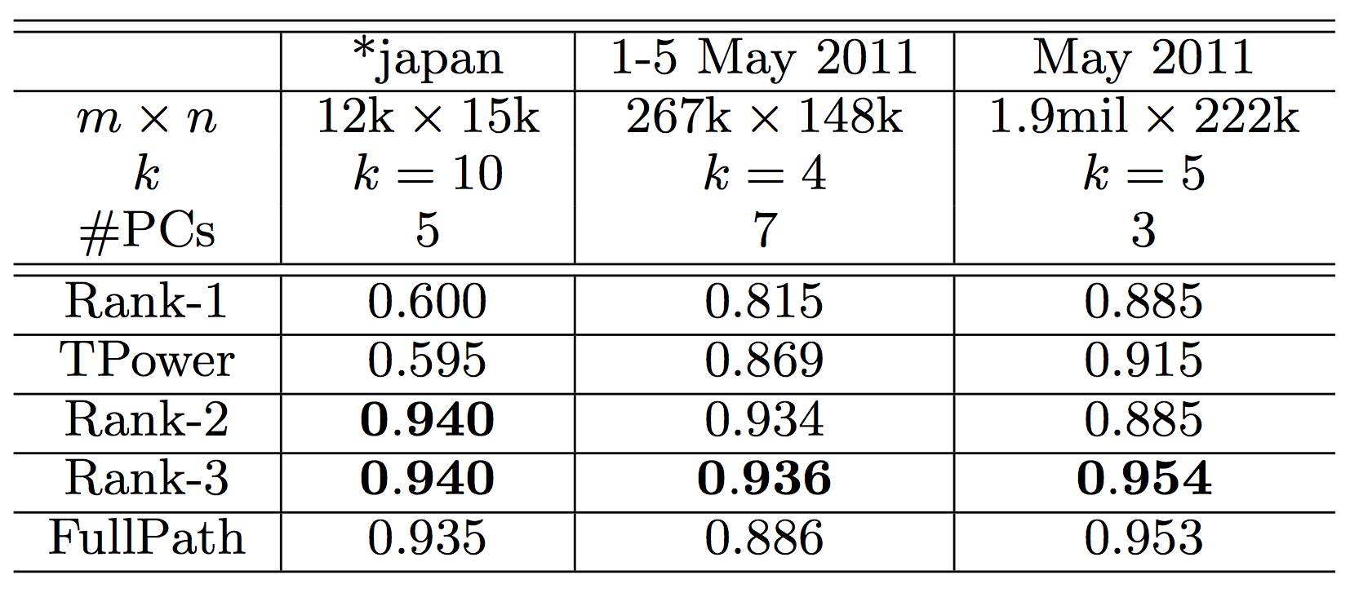
Experiments
Data set: 10M Tweets from Greek users
Time window: Jan 2011-June 2011

Slide 23
Experiment: May 10, 2011
k=10, top 4 sparse PCs for the data set (65K tweets, 64K unique words)
Spannogram:
skype, microsoft, acquisition, billion, acquired, acquires, buy, dollars, acquire, google
Eurovision, greece, lucas, finals, final, stereo, semifinal, contest, greek, watching
love, received, greek, know, damon, amazing, hate, twitter, great, sweet
downtown, athens, murder, years, brutal, stabbed, incident, camera, year, crime
FullPath:
eurovision, finals, greek, greece, lucas, semifinal, final, contest, stereo, watching
love, received, damon, greek, hate, know, amazing, sweet, great, songs
skype, microsoft, billion, acquisition, acquires, acquired, buying, dollars, official, google
Twitter, facebook, welcome, account, good, followers, census, population, home, starts
Tpower:
greece, greek, love, loukas, finals, athens, final, stereo, country, sailing

Slide 24
Conclusions
We presented a new combinatorial approximation algorithm for Sparse PCA
Constant factor approximation for any reasonable matrix
Arbitrary approximation for power-law decay
General spectral bound
Empirically outperfoms previous state of the art
Parallel Mapreduce implementation?

Slide 25
the end

